Slide 1
CSC 460: SmallData POD 2 Databases
William Ng, Zakaria Chowdhury, Jawad Kabir, Jawad Chowdhury, Timson Tan, Darren Ling

Slide 2
Introduction
Agenda Overview:
Quick preview of each module: SQL, NoSQL, Cloud DB, and Docker
History and evolution of each database type.
Overview of tabular comparison on features, use cases, and pros/cons.
Discussion on industry relevance and recommendations.
Goal:
To explore how different databases serve varying needs and discuss hosting solutions for collaboration.

Slide 3
Table of contents
01
Overview of Databases
02
SQL vs NoSQL
03
Cloud Hosting
04
Introduction to Docker
What is a database?
Differences of each category
What is Cloud Hosting and their uses for them?
What is Docker?

Slide 4
Table of contents
05
Hosting Databases Locally vs in the Cloud
06
Pros and Cons
07
Personal Recommendations
08
Conclusion and Q&A
Exploring database hosting options
Comparing each database
Opinions on what we think is best
Wrap it up with a following Q&A session

Slide 5






Small Data
This presentation is brought to you by:
Timson T
William N
Zakaria C
Darren L
Jawad K
Jawad C

Slide 6
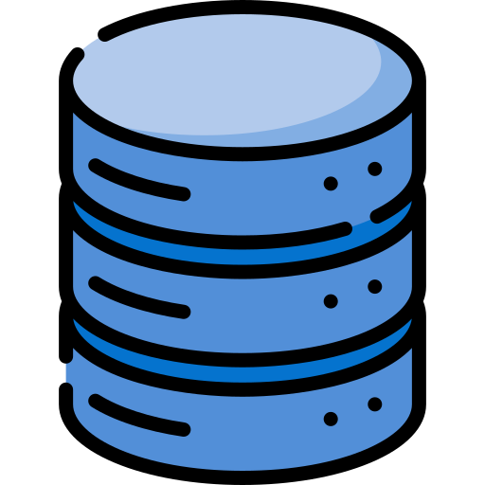
What is a Database?
A database is a system designed for storing, managing, and retrieving data efficiently. First Introduced in 1970, Edgar F. Codd, a computer scientist at IBM, introduces the relational database model in his paper "A Relational Model of Data for Large Shared Data Banks."
It allows users to organize data in a structured format, ensuring easy access and manipulation. There are two types of databases that are relevant to current Industry, SQL and NoSQL databases.

Slide 7
What is SQL and NoSQL?
SQL (Structured Query Language):
Relational databases that use structured schemas.
Ideal for structured data with predefined relationships (e.g., tables).
ACID Transaction (Atomicity, Consistency, Isolation, Durability)
NoSQL (Not Only SQL):
Non Relational databases that allow for flexible schemas.
Suitable for unstructured or semistructured data, accommodating rapid changes.
BASE ( Basically Available, Soft State, Eventually Consistent)

Slide 8
History
1970
1980
1990
2000
2010
2020
Birth of SQL
Rise of SQL
Growth of Relational Database
Emergence of NoSQL
NoSQL popularity Surge
Continued
Evolution
Notes:
Timeline of SQL and NoSQL Databases
1970s: Birth of SQL
1970: Edgar F. Codd, a computer scientist at IBM, introduces the relational database model in his paper "A Relational Model of Data for Large Shared Data Banks."
1974: The term "SQL" (Structured Query Language) is introduced as a query language for managing relational databases.
1980s: Rise of SQL
1981: IBM releases System R, the first implementation of a relational database management system (RDBMS) using SQL.
1986: The first SQL standard (SQL86) is published by ANSI (American National Standards Institute), solidifying SQL as the standard language for RDBMS.
1990s: Growth of Relational Databases
1990: Oracle Corporation releases Oracle Database, further popularizing SQL databases in enterprise applications.
1995: Microsoft releases SQL Server, expanding the use of SQL databases in the Windows environment.
2000s: Emergence of NoSQL
2000: The term "NoSQL" is coined by Carlo Strozzi to describe a relational database that does not use SQL.
2006: Amazon releases Dynamo, a highly available key value storage system, paving the way for NoSQL databases designed for scalability and performance.
2010s: NoSQL Popularity Surge
2009: The open source database MongoDB is released, providing a document oriented approach to data storage.
2011: Apache Cassandra gains popularity for its distributed, fault-tolerant design.
2012: The rise of big data leads to increased interest in NoSQL databases, with various types (document, key-value, column-family, graph) becoming widely adopted.
2020s: Continued Evolution
2020s: SQL and NoSQL databases coexist, with organizations leveraging both to meet different data storage needs. Hybrid approaches and multi model databases gain traction, allowing flexibility in data management.

Slide 9
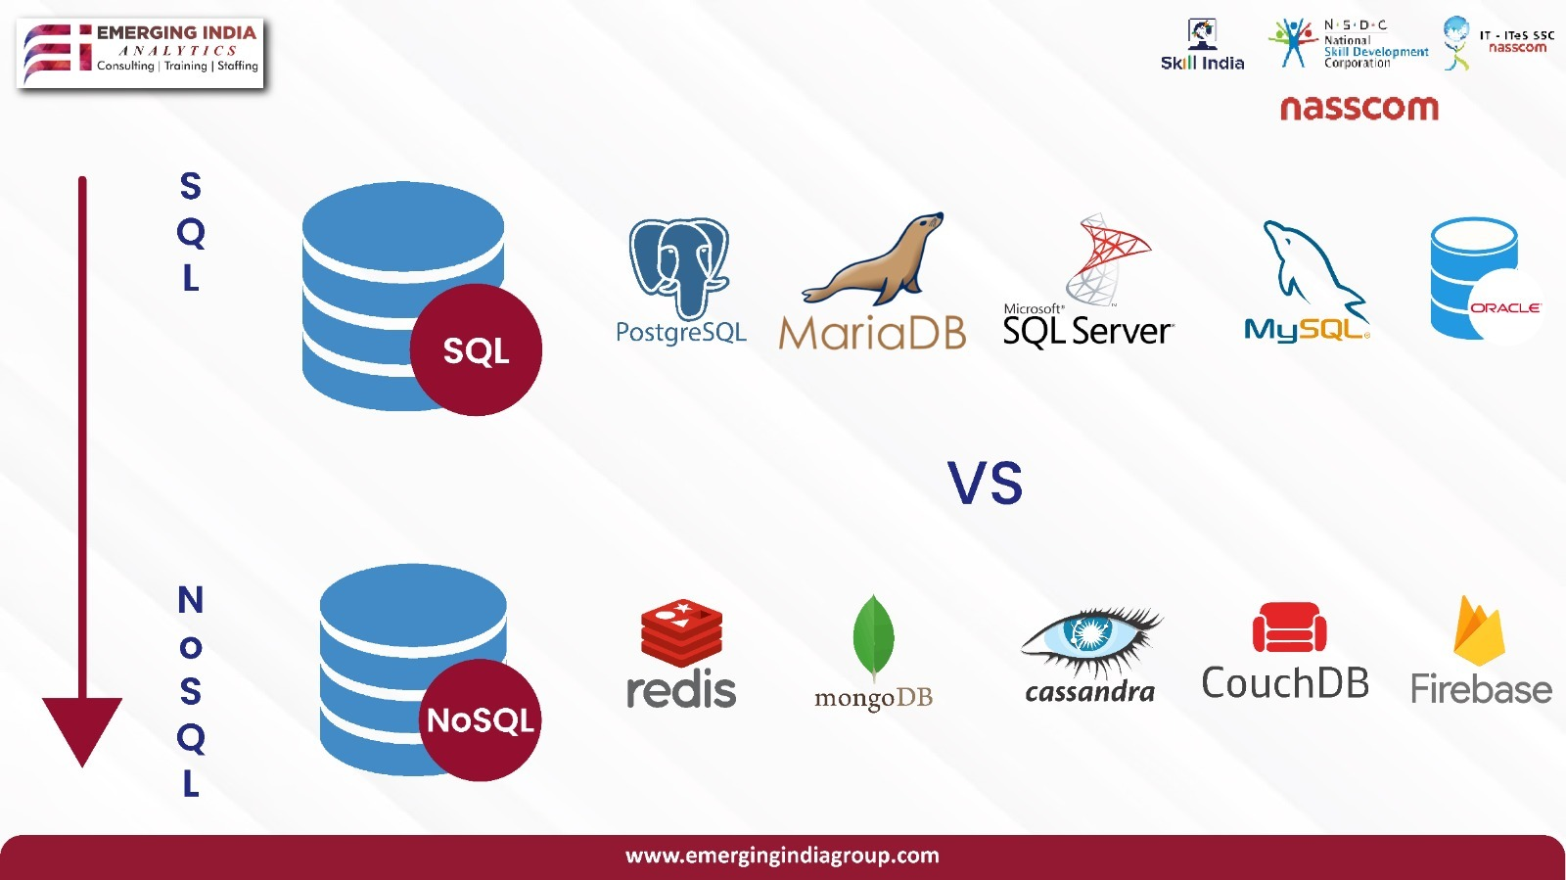
Examples of SQL and NoSQL
SQL Database
MySQL
PostgreSQL
Microsoft SQL Server
Oracle DB
Azure DB
NoSQL Database
MongoDB
Redis
Cassandra
DynamoDB
Firebase
VS

Slide 10
Cloud DBs
Cloud Hosting allows users migrate databases remotely for better scalability .
Amazon RDS
Microsoft Azure
Google Cloud
Pros:
Flexible ay-as-you-go model.
Automatic backups of DB
Cons:
Costly for large-scale deployment
Scaling downtime
Pros:
Reduced latency - global distribution.
Automated scaling by demand
Cons:
Less budget-friendly than Amazon RDS.
Query complexity increased due to consistency models.
Pros:
Easy integration with Google products
Flat rate pricing for BigQuery, a service for data analytics.
Cons:
Limited RDBMS offered
Higher costs to transfer data out of ecosystem.

Slide 11
Hosting DBs on the Cloud vs Locally
Cloud Hosting :
Benefits include scalability, reduced maintenance, improved accessibility, and monitoring.
Can be more expensive in the long run, and you have less direct control over your data.
On Premises Hosting :
Direct control over your data, can be more cost effective.
You’re responsible for all maintenance, and scaling.

Slide 12
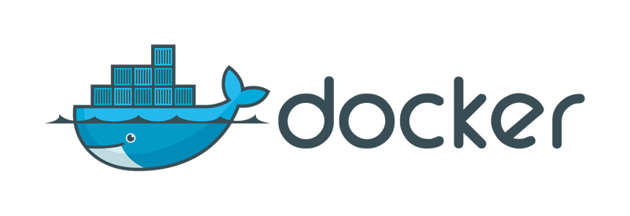
What is Docker?
Docker
Containerization :
Ensures all users can access a service regardless of working environment
Your project is portable and scalable
Run your projects in isolation
Lightweight solution as opposed to virtualization

Slide 13
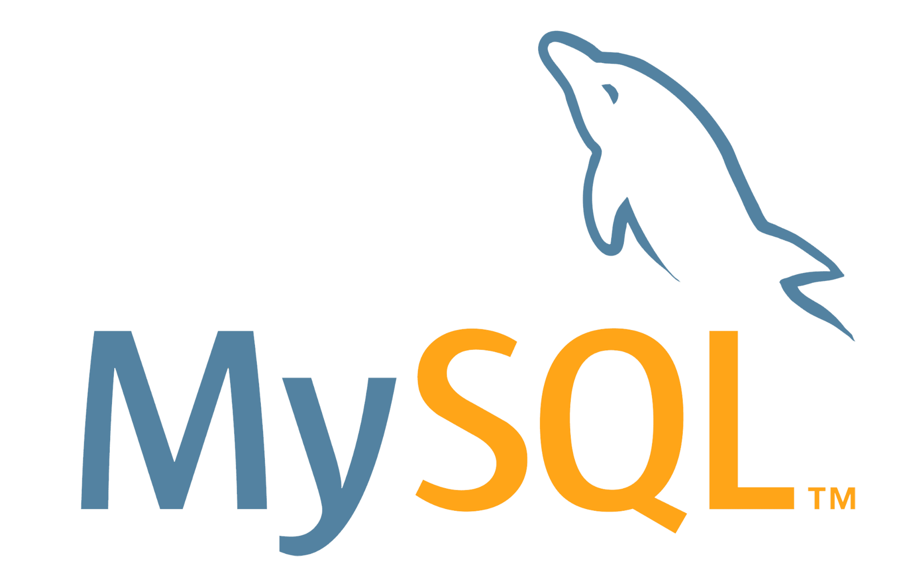

Pros & Cons (SQL DBs)
Easily Managed
Faster for Simple Queries
MySQL
Scalability Issues
Limited Support for Advanced Features
Advanced Features
Extensibility
PostgreSQL
Slower in simple readheavy scenarios
More Complex to Set Up

Slide 14
Pros & Cons (NoSQL DBs & Others)
MongoDB
AWS S3
ElasticSearch
Redis
Flexible Schema
Very scalable
High storage overhead
ACID limitations
Highly scalable storage
Low cost
Latency
Limited querying
Full Text search
Real time indexing
High memory usage
Complex setup
In Memory data store
Versatile use cases
Data persistence
Memory limitations

Slide 15
Conclusion And Recommendations
Small Projects:
Recommended to use SQL databases for simple, structured projects, and easier management
Large Projects:
Recommended to use NoSQL databases or cloud solutions for better scalability
Docker:
Should be used to avoid the “it works on my machine” problem
Great for portability, scalability, and security
Very lightweight and easy to orchestrate

Slide 16

Thanks!
This was a presentation presented by Small Data

